Slide 1
Sustainable Water Integrated Management SWIM-SM second Steering Committee Meeting,
Brussels, 17-18 October 2012
Round table on synergies with regional organisation/programmes/initiatives
The ENPI-SEIS Project
‘Towards a Shared Environmental Information System (SEIS) in the European Neighbourhood’
European Environment Agency
Cecile RODDIER-QUEFELEC,
Mediterranean Area Cooperation, Governance and Networks Programme

Slide 2
The ENPI-SEIS project
Overall objective:
  Promote the protection of the environment in the countries of the European Neighbourhood Policy area
Specific objectives:
  Identify / further develop environmental indicators
  Improve capacities in the field of monitoring, collection, storage, assessment and reporting of environmental data
  Promote the setting up of national and regional environmental information systems in line with SEIS principles
  Track progress of the regional environmental initiatives (European Neighbourhood Policy, Eastern Partnership, Barcelona Convention, Horizon 2020 etc.)

Slide 3
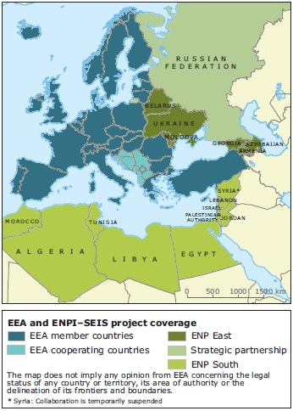
Two National Focal Points nominated (Env and Statistics) by Partner countries
Cooperation with UNEP/MAP (indicators&data; infrastructure, assessment, regional and country support (e.g. Indicators, Nat. Info System, PRTR)
EEA/ETC
Framework Contractor

Slide 4
H2020 Review, Monitoring & Research sub group and the ENPI-SEIS project
The ENPI-SEIS project implemented by the EEA is supporting the RMR activities and the development of a review mechanism of H2020 progress.
Focus on Horizon 2020 priorities
  Water:
    fresh water and marine
    urban waste water
  Waste: municipal waste
  Industrial emissions

Slide 5
Applying SEIS Conceptual Framework
to ENP South region
Municipal waste,
Urban waste water,
Industrial emissions,
Freshwater, Marine,
air pollution etc.
Data flows +
Indicator development
Shared content
Data and information
Services, SDI
SEIS (tools and systems)
Infrastructure
Institutional
cooperation
Environment & Statistics, UNEP/MAP etc.
Bilateral cooperation
5
Notes:
In the process of SEIS implementation the three components will be addressed — content, infrastructure and cooperation

Slide 6
Activities carried out so far
Country visits to all partners countries
    Country reports listing actions/pilots to be implemented e.g. specific indicators, PRTR, info. Systems, etc.
H2020 Review Mechanism
  RMR + Working Group on Environmental Indicators
  Identification and selection of key H2020 indicators
  Development of indicators factsheets and methodology
  Mapping and establishment of corresponding data flows/ reporting
  Pilot development (waste, PRTR, water accounts, etc.)
Assessment report of H2020
    Synthesis, indicator based thematic assessment and country assessment
    to be issue mid-21013

Slide 7
Activities carried out so far (con’t)
Ensure data flows
  Working Group on IT
  Meta data structure, classification
  National Information system
  Streamline existing data collection activities
  Reporting mechanisms
Workshops
  Water accounts
  Pollutant Release and Transfer Register (MED POL)
  Waste (2013)
Preparation of a SEIS ‘Cookbook’
  http://www.seiscookbook.net

Slide 8
H2020 Indicator
Municipal waste generation per capita
Amount of collected waste
  Type of treatment of municipal waste (recycling, incineraton, landfill etc.)
  Number, type and location of landfills
Volume of waste water collected, of which volume of waste water treated by the public sanitation system
  Type of treatment of waste water (primary, secondary, tertiary)
Share of population with access to an improved* sanitation system (total, urban, rural)
Nutrient concentrations in coastal waters
Release of toxic substances and nutrients from industrial sectors

Slide 9
The way forward – possible synergies with SWIM
Governance
  Demonstrate the benefits of information sharing and enhance data sharing policy (access vs. confidentiality)
  Develop appropriate governance model and reinforce cross-cutting cooperation between departments & countries
  Strengthen partnership
Information / knowledge production
  Support countries in developing their national information nodes (better coordination, knowledge transfer, capacity building)
  Develop comparable methodology, selection of parameters to be monitored (common set of indicators)
  Water accounting
  Contribution to the production of H2020 assessment report (thematic, country assessment)
Communication / dissemination
=> ENPI-SEIS Steering Committee 21-22 November, Copenhagen

Slide 10
Towards a Shared Environmental Information System in the European Neighbourhood
Thank you for your attention!
http://enpi-seis.ew.eea.europa.eu/

