Slide 1
All Across the Jordan: Trans-boundary FOEME Master Plan of the Lower Jordan River Basin
SWIM Steering Committee Meeting
October 17-18, 2012
www.foeme.org| info@foeme.org

Slide 2
Objectives
To create a regional NGO master plan for the Lower Jordan River by developing and harmonizing national master plans into a single cohesive NGO transboundary master plan.
Project will lay the groundwork for effective transboundary water governance for integrated water resource management of the Lower Jordan River.
Advance dialogue with decision makers and stakeholders from Jordan, Palestine and Israel to strengthen regional cooperation and contribute to peace building.

Slide 3
Activities to Date
RHDHV team selected through an international tender process to undertake the development of the NGO Master Plan.
Team led by RHDHV with leading regional experts from Jordan, Palestine and Israel.
RHDHV presented its work plan for feedback at the first SWIM JR SIWI Middle East Seminar.
RHDHV inception report due November 6, 2012.

Slide 4
Activities to Date
First SWIM-JR SIWI Middle East Seminar held September 9-11, 2012 in Amman bringing together approximately 80 high level officials from the region, including representatives of all key Jordanian, Palestinian and Israeli decision making bodies relevant for the rehabilitation of the Lower Jordan River, representatives of four major transboundary river basins, SWIM demo projects as well as numerous leading international experts on transboundary river management.

Slide 5
Synergies and interlinks with SWIM SM and Demonstration Projects
SWIM Focal Points participated in SWIM JR SIWI Mid-East Seminar.
SWIM Demonstration projects invited to present at SWIM JR SIWI Middle East Seminar September 2012.
Proposed assistance opportunities to SWIM SM including:
utilize and adopt the IWRM material that SWIM SM is preparing
suggested that SWIM SM host a series of "Euro-Med expert tours and discussions" on key issues of transboundary river basin management such as water, environment and tourism
Coordination towards the SWIM SM Documentary Film.

Slide 6
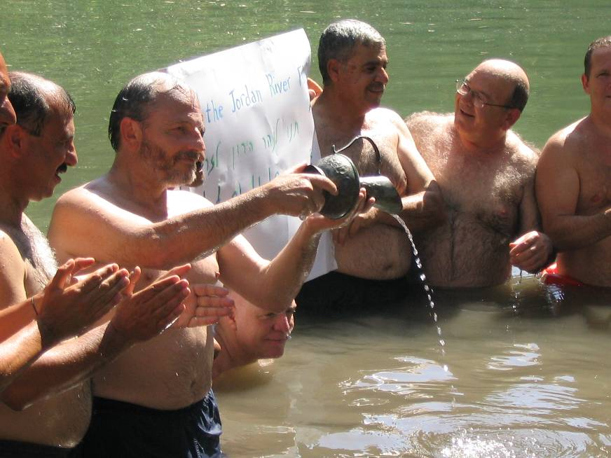
Progress in Research Undertaken
Working together towards a new future for the Lower Jordan River
For more information visit:
www.foeme.org

